Slide 1
Capstone 1: Building a Song Preference Prediction Model
Aaron kochman

Slide 2
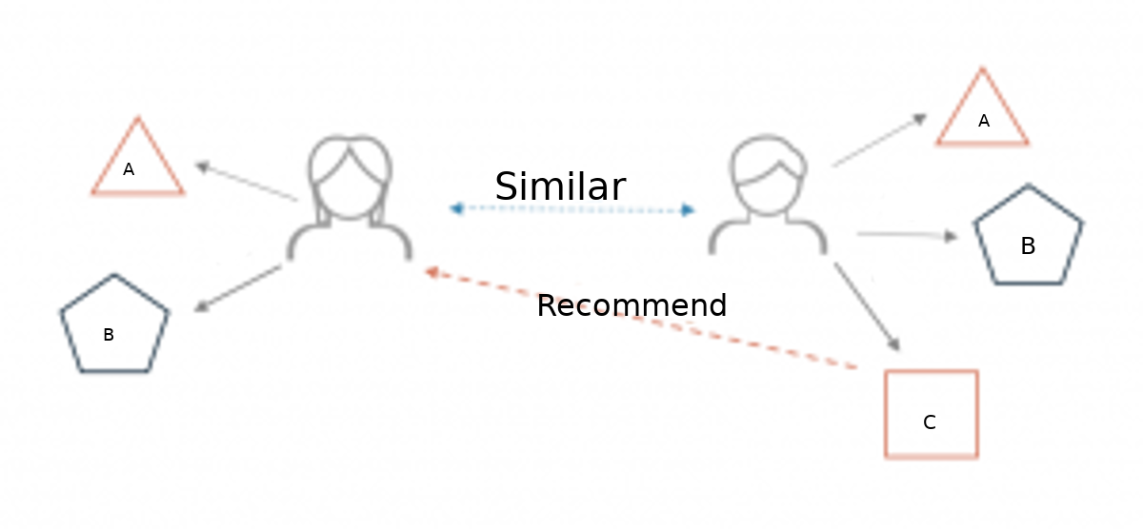
Recommender Systems
Predict what items users prefer
Model-based or Memory-based
Used by many companies including Spotify, Amazon, Apple
Can increase user interaction and sales

Slide 3
Capstone question
Can we accurately predict song preferencing using Spotify’s API Spotipy and machine learning?

Slide 4
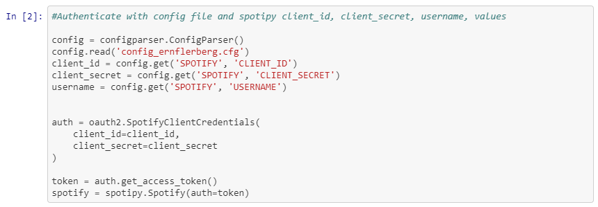
Data Wrangling
1. USERNAME: Spotify account id.
2. CLIENT_ID: The client id from the Spotify for Developers page.
3. CLIENT_SECRET: The secret generated for the specific Spotify Application on your Spotify Developer page.

Slide 5
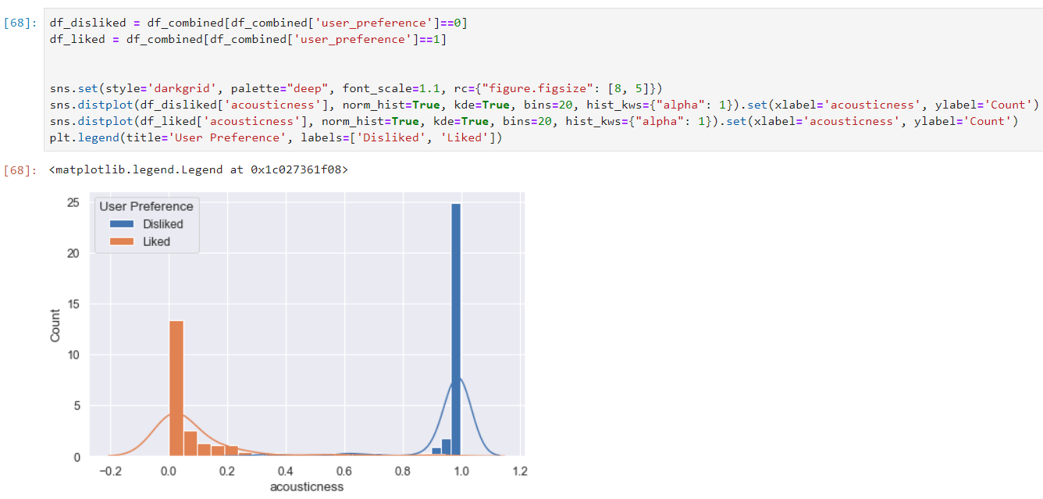
Data Story

Slide 6
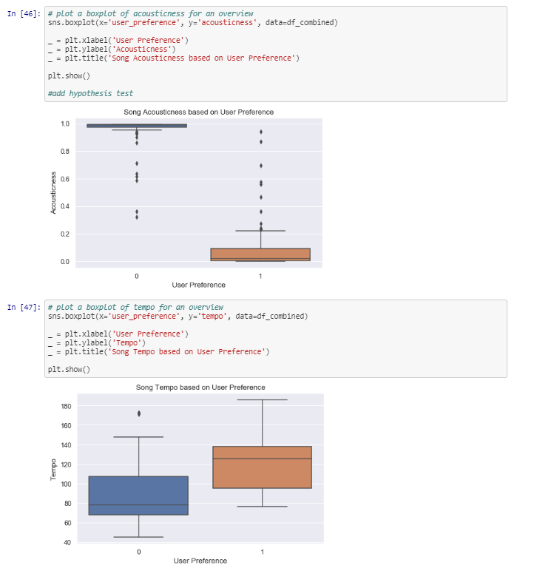
Data Story
Each playlist produced different metrics for tempo, loudness, energy, danceability, spechiness, acousticness, valence, and instrumentalness

Slide 7
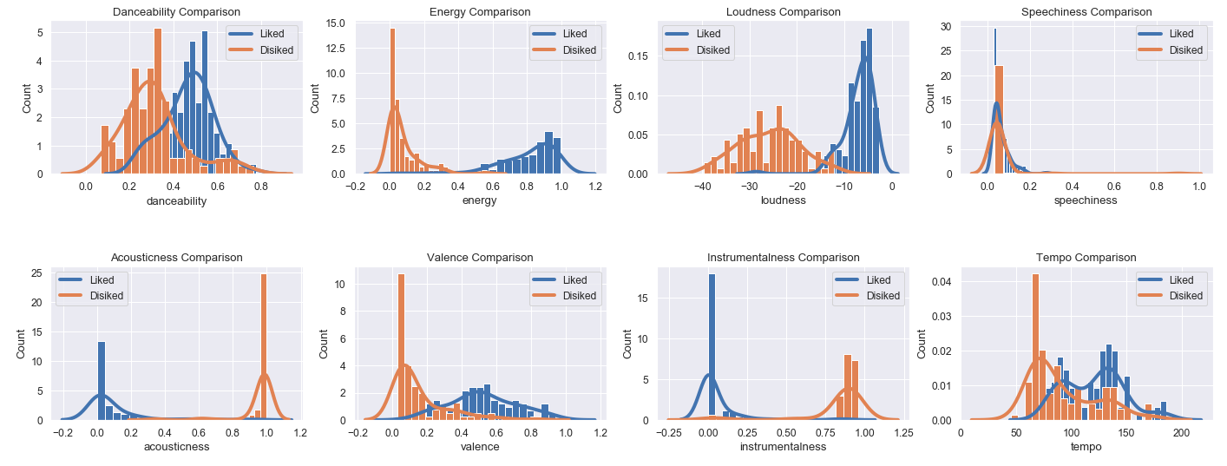

Slide 8
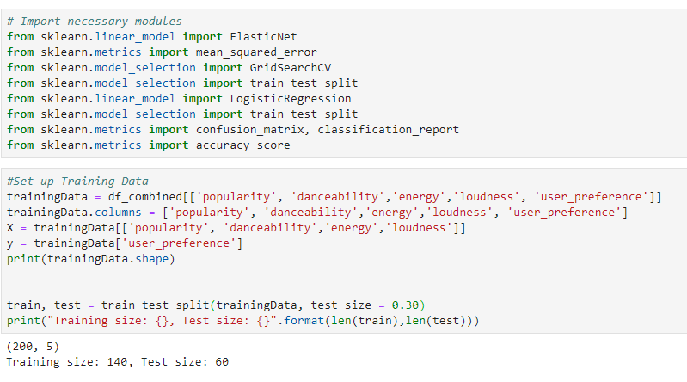
Machine Learning
Playlist with Liked/Disliked songs was used for training
Prediction playlist had songs from Spotify’s Discover Weekly, as well as songs that I knew I would not prefer

Slide 9
Machine Learning
Logistic Regression
Random Forests
Decision Trees
Support Vector Machines
k-nearest neighbors (KNN)

Slide 10
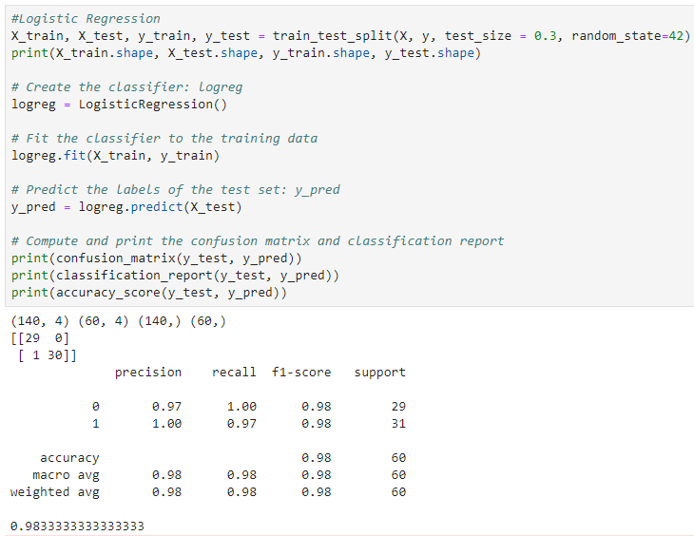
Machine Learning – Logistic Regression
Logistic Regression produced results with 98% accuracy

Slide 11
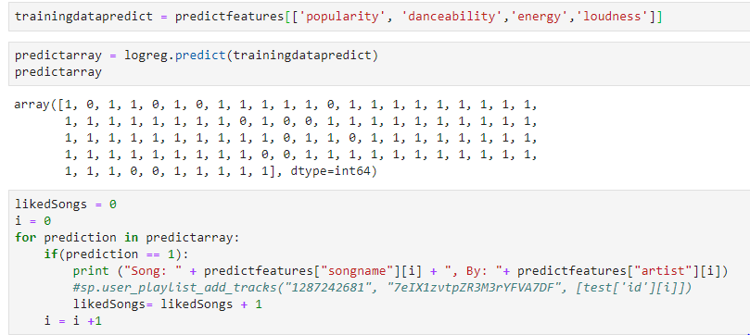
Prediction Model
Logistic Regression was used and predicted that the user would like 85 (87%) of songs on the Prediction Playlist

Slide 12
Conclusion
Logistic Regression is an accurate machine learning model to use for a song recommender system if the training playlists are significantly different.

